Slide 1
WSDM - KKBox's Churn prediction challenge
By Kevin Rotairo

Slide 2
Contents
Data Science Problems
Data Preparation
Models
Insights
Evaluation
Recommendation

Slide 3
Data Science Problems
Predicting if a customer will churn by around April 2017
Reading and analyzing enormous data from client

Slide 4
Data Preparation

Slide 5
Data
members.csv.7z
1
~186Mb
Contains each member’s basic info
transactions.csv.7z
2
~675Mb
Contains each member’s billing records
train.csv.7z
3
32Mb
Gives information if user churned on March 2017
user_logs.csv.7z
4
User’s listening logs
~6.65GB
sample_submission_zero.csv.7z
5
~31Mb
User msno to be predicted

Slide 6
Environment setup
Create 2 remote machines on Digital Ocean (8GB RAM with 4 Cpu’s)
1
Setup Jupyter notebook and python on remote environment
3
Host jupyter on remote machines and connect through local browser
4
Download files from Kaggle
2

Slide 7
Data preparation
Check if files can be handled by machine. (user_logs is too large for the machine)
1
Aggregate key features
3
Separate features and dependent variable
4
Perform exploratory analysis (visuals on the following slides)
2

Slide 8
Exploring the data (using Tableau)

Slide 9
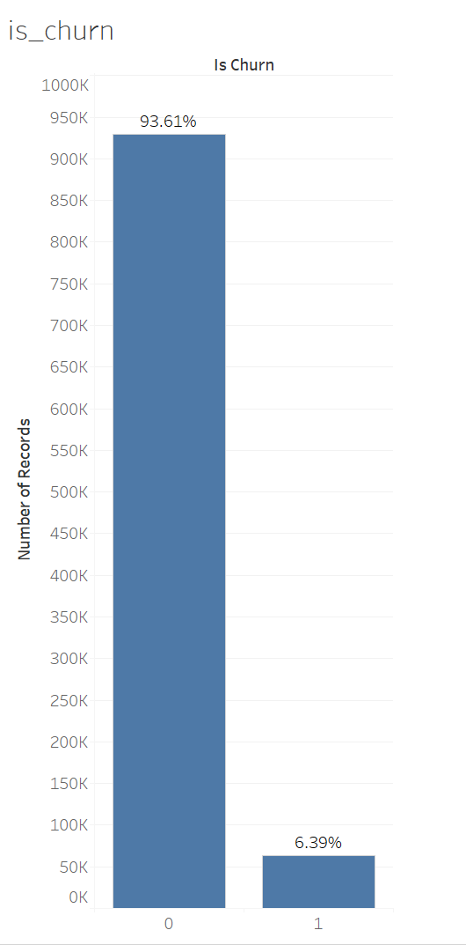
We can immediately see that the data is very unbalanced, almost 94% is labeled as 0.
Therefore, we cannot simply use statistical models as it will be biased to the majority class.

Slide 10
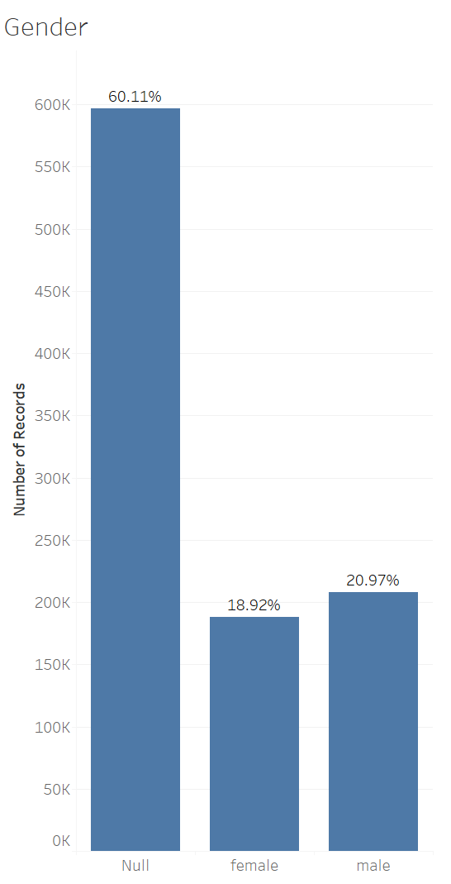
Majority of the gender field is also unfilled so I considered to not include gender as a feature in my final features
2

Slide 11
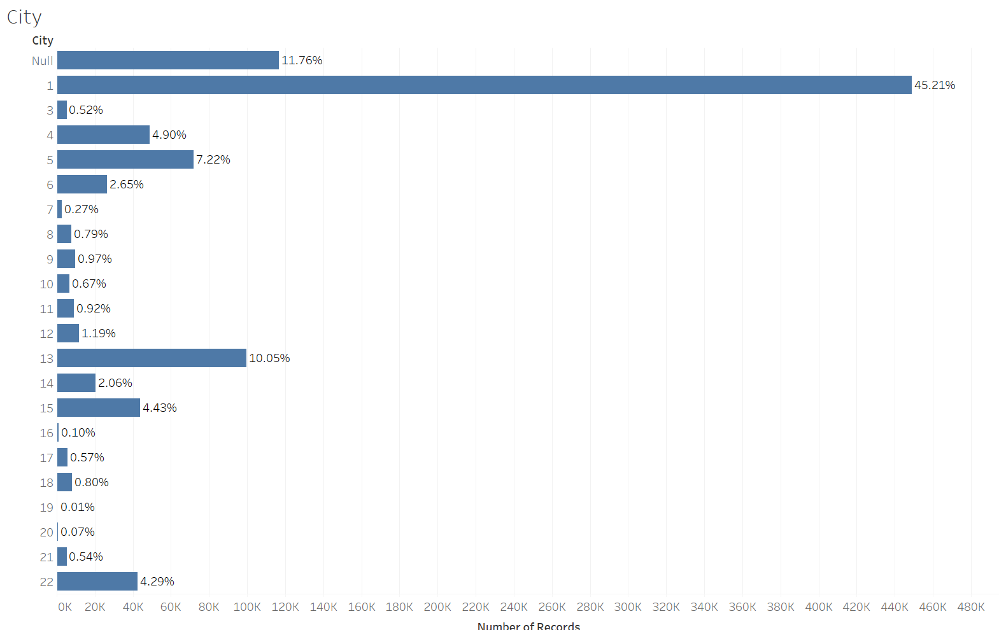
Though there are nulls, we still have majority of the city data with labels. We can use this as a feature and it can be observed that majority of users are from city 1 (almost half)

Slide 12
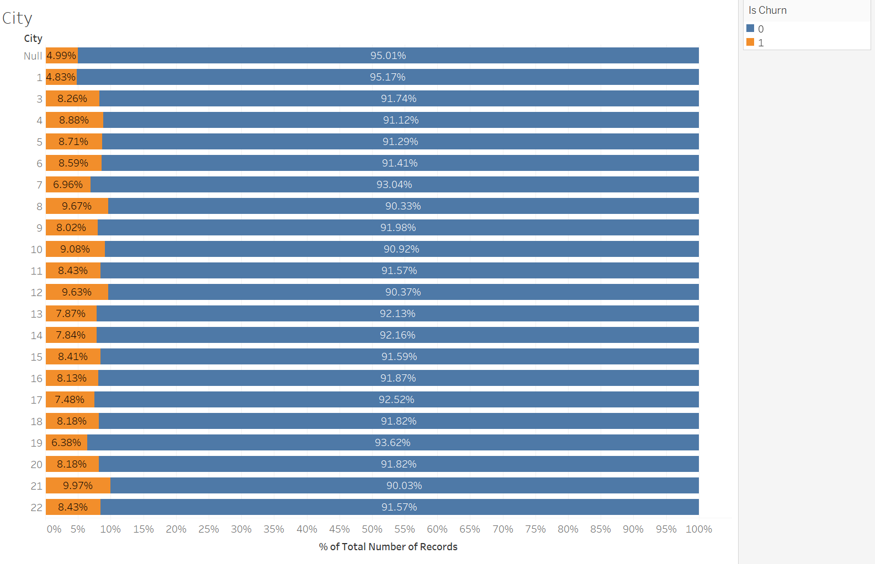
We can also see that the distribution of those who churned for each location seems to be the same

Slide 13
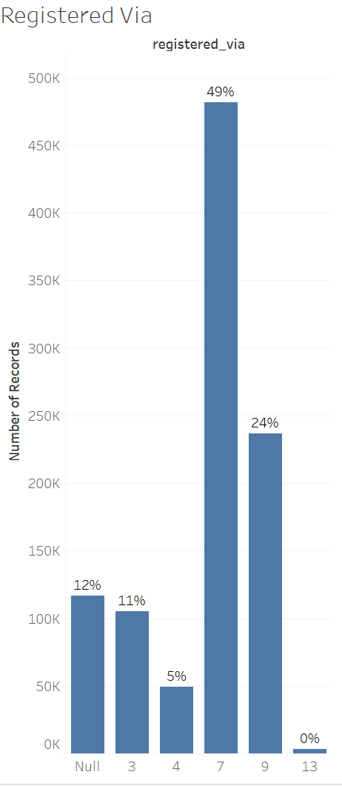
Majority of the registration method can also be found. We can use this as a feature and it can be observed that majority of users prefer method 7
13

Slide 14
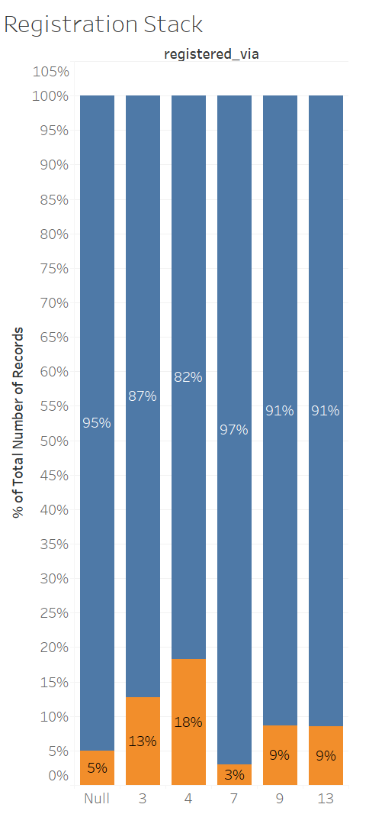
The number of users for each registration id seem to correlate with the number of users who churn
14

Slide 15
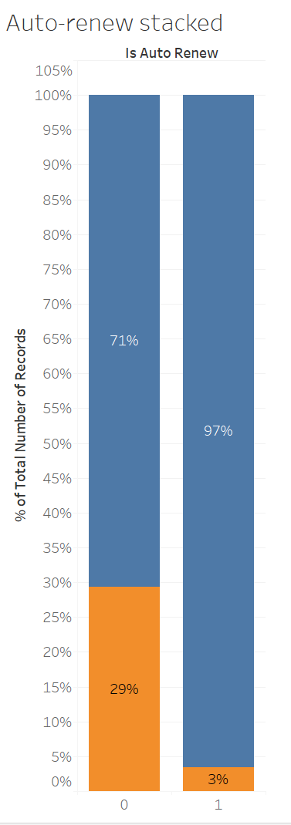
From the transactions table, we can see that there is a big difference between the number of churning users who did not choose to auto-renew
15

Slide 16
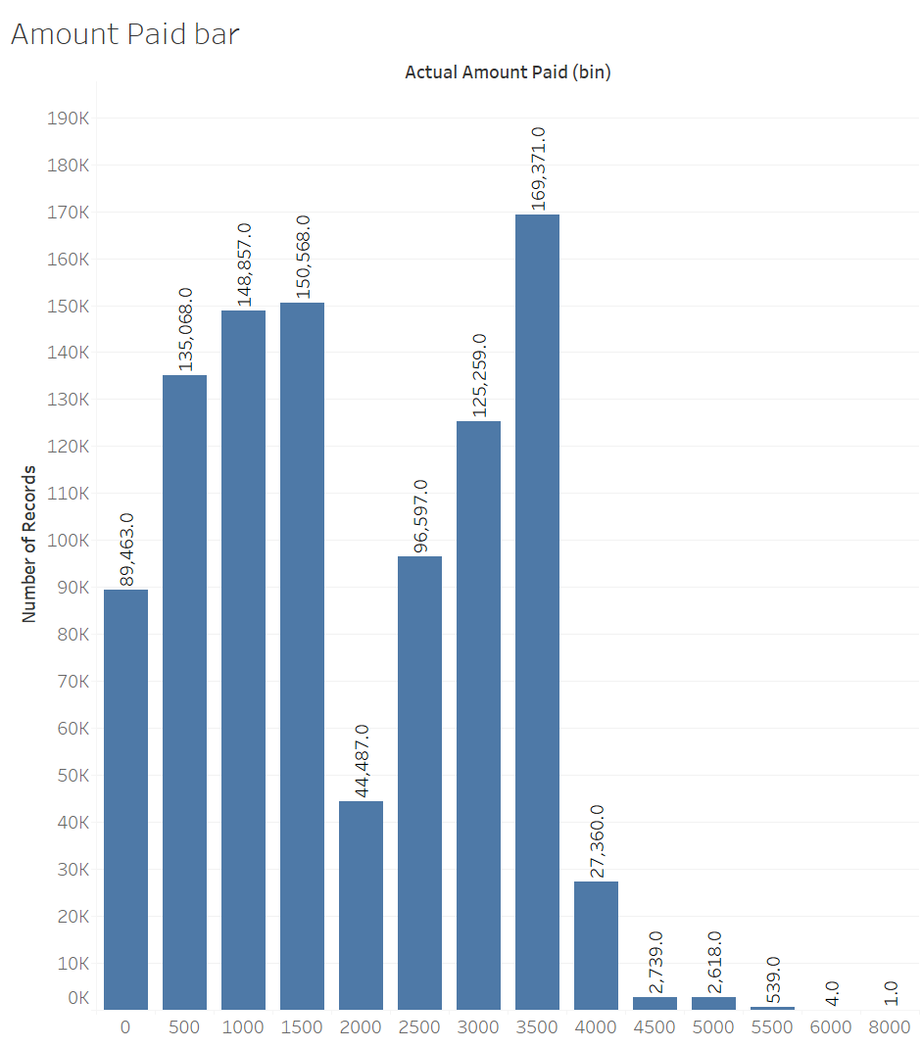
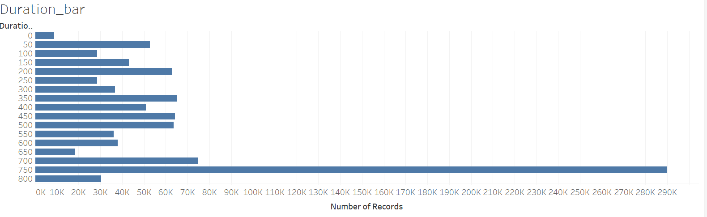
Total amount paid and number of days subscribed are features I derived from the transactions.csv file

Slide 17
Models

Slide 18
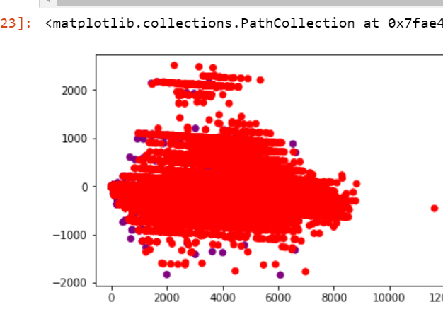
I still tried logistic regression and used SVD to reduce all my features to 2 and plot

Slide 19
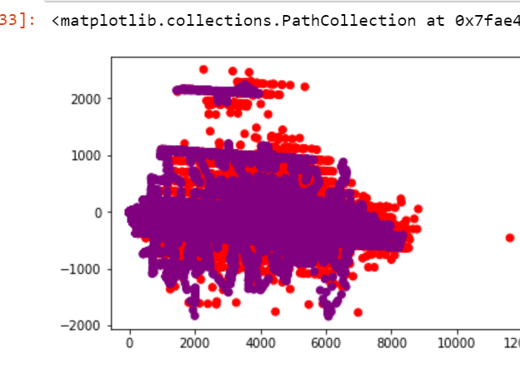
Then I used SMOTE to synthetically generate more of the minority class (over sampling)

Slide 20
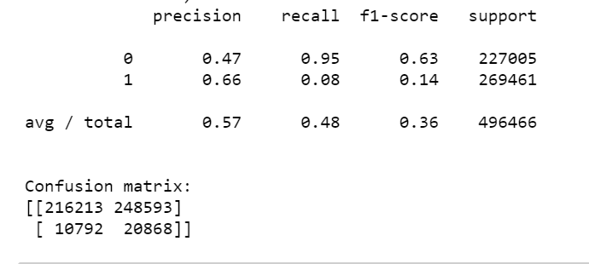
But the results were really bad.

Slide 21
So I used decision trees and boosting
1st Submission
Incorrect (I predicted the churn value not its probability)
Logloss: 15.56331
2nd Submission
Overfit
Logloss: 0.32831
3rd Submission
Better than before
Logloss: 0.27354
4th Submission
Using RandomForest with RandomizedSearchCV for parameter optimization
Using RandomForest with RandomizedSearchCV for parameter optimization
Using XGBoost with RandomizedSearchCV for parameter optimization
Better than before
Logloss: 0.25307
Using XGBoost with RandomizedSearchCV for parameter optimization

Slide 22
My current rank is:
Rank 157th

Slide 23
Next Steps
Expand RAM and CPU for faster model training
Explore correlation and feature importance of each features generated
I was able to read the user_logs using dask dataframe but was not able to compute anything from it. So I’ll continue to work on it

